Slide 1
ME 4271 Final Project: Thermal System of an Electric Vehicle
Group 3:
Isai Alcaraz
Isabella Davila
Shruthika Ilavarasu
Maghen Saltzman
Chiara Wu

Slide 2
Design Parameters
Designing the thermal system of an electric vehicle
Total vehicle weight of 8,000 lbs
Rolling friction coefficient of 0.015
Constant bluff body drag coefficient of 0.30
Constant bluff body lift coefficient of 0.03
Acceleration capability of 0 to 65 MPH in 3 seconds time frame
Rough dimensions of 221” length, by 84” width, by 77” height
Seating for 5 passengers and 1 driver
Presented by: Isabella Davila

Slide 3
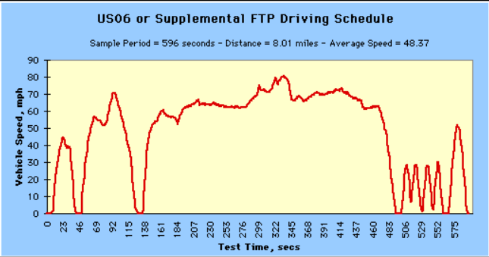
Drive Cycle Velocity Profile
Aggressive driving schedule, epanded over 12 hours
Consider 10% grade
Presented by: Maghen Saltzman

Slide 4
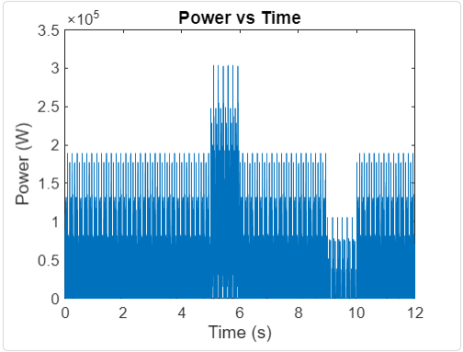

Power Calculation
W_{car} + W_{people}
P/V
D
$$θ$$
f
N
L
Power profile calculated in matlab
Higher for incline, lower for decline
Presented by: Maghen Saltzman

Slide 5
Environmental Conditions: Requirements
Varying air temperature and solar flux peaking at 12PM
Sunrise time is 6AM and Sunset time is 6PM, making it a 12 hour day.
Peak temperature occurs at 35 degrees Celsius (95 F) in the middle of the day
How this effects the system:
Included in HVAC subsystem
Radiator effects to front of the vehicle: Sunrise-12PM
Elevation due to 10% grade: 7.8km from 12PM-3PM
Presented by: Shruthika I.

Slide 6
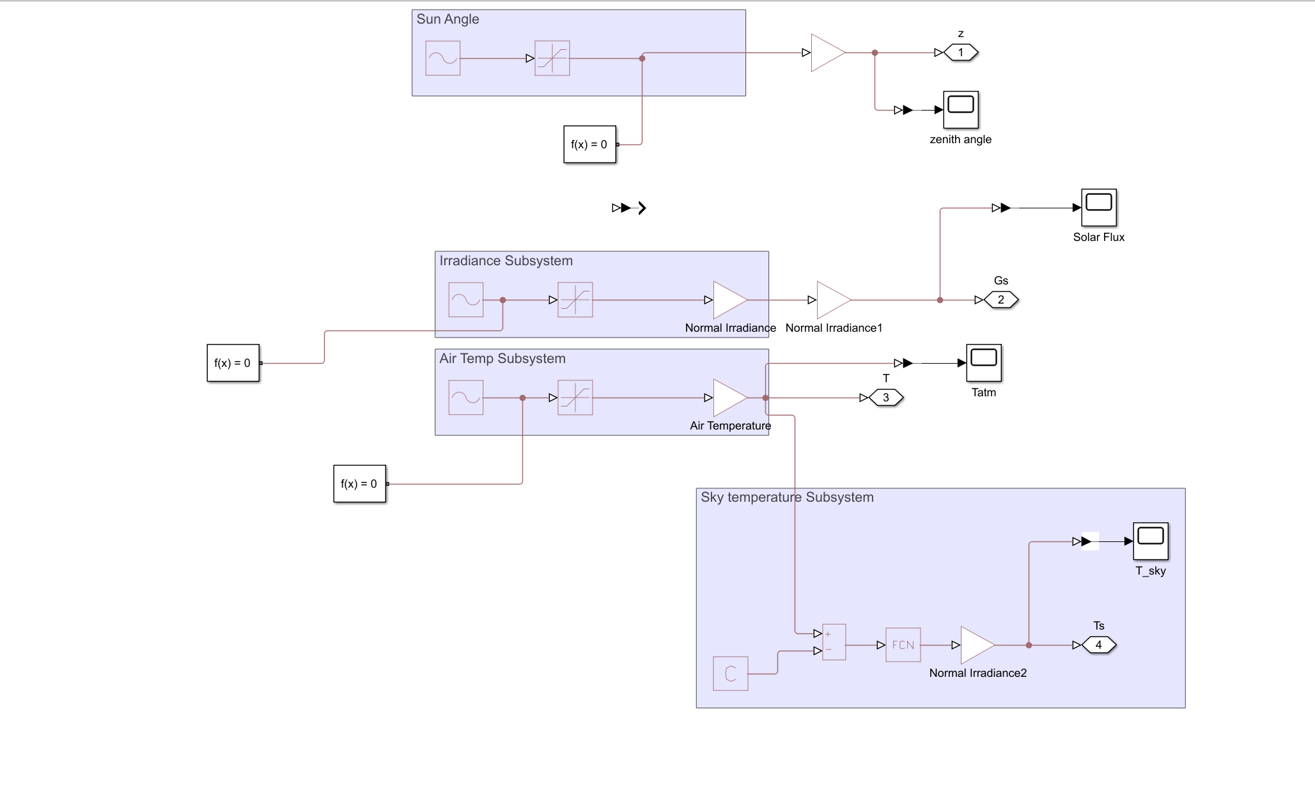
Environmental Conditions: Subsystem
Presented by: Shruthika I.

Slide 7
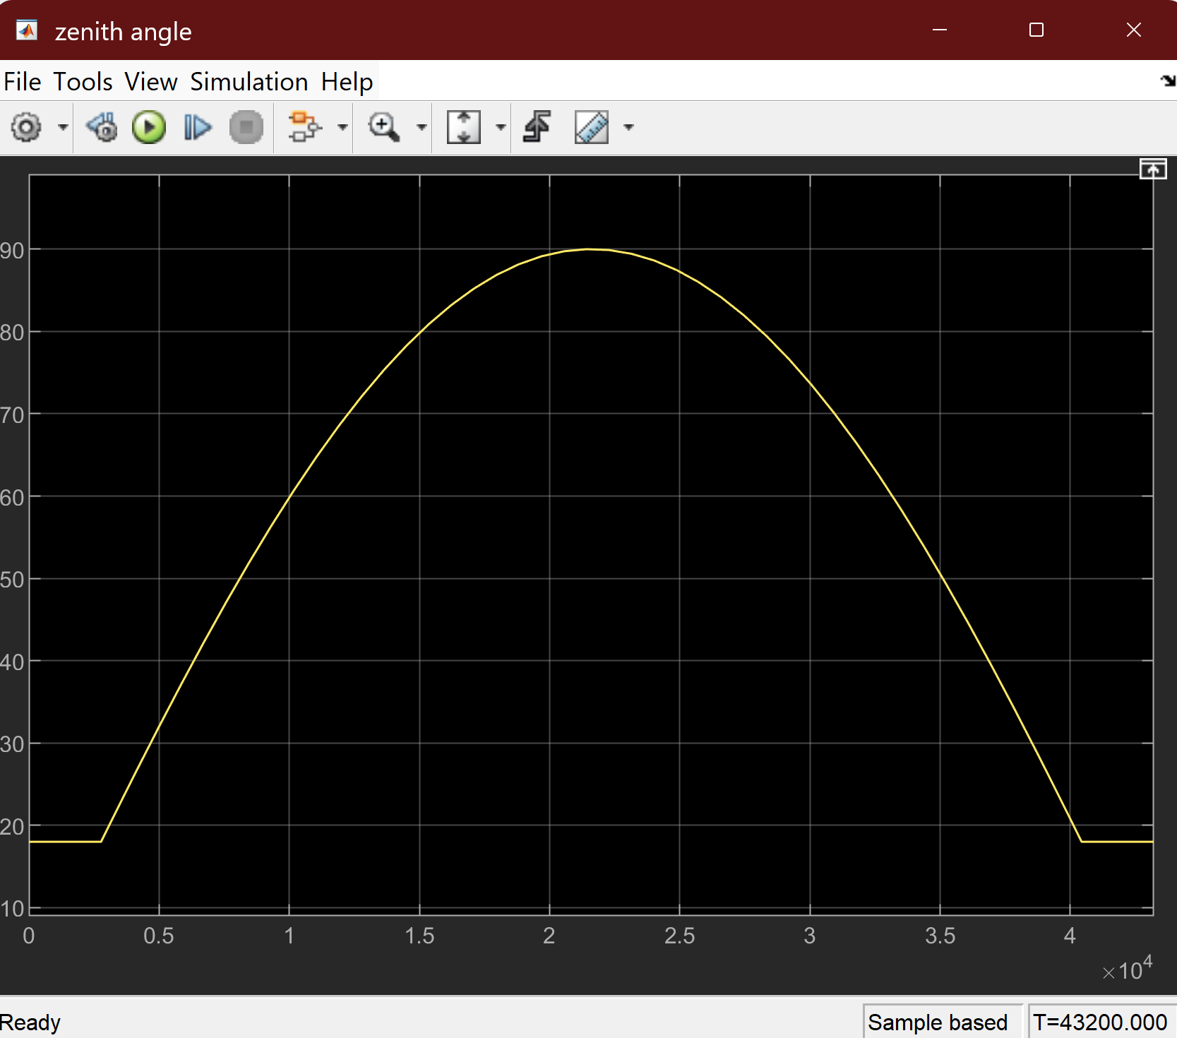
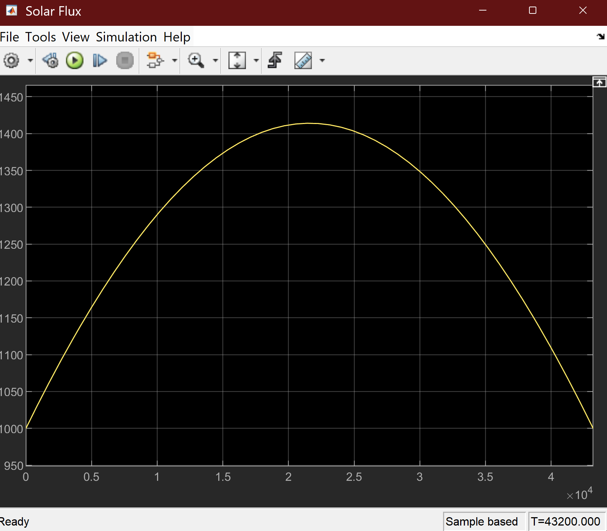
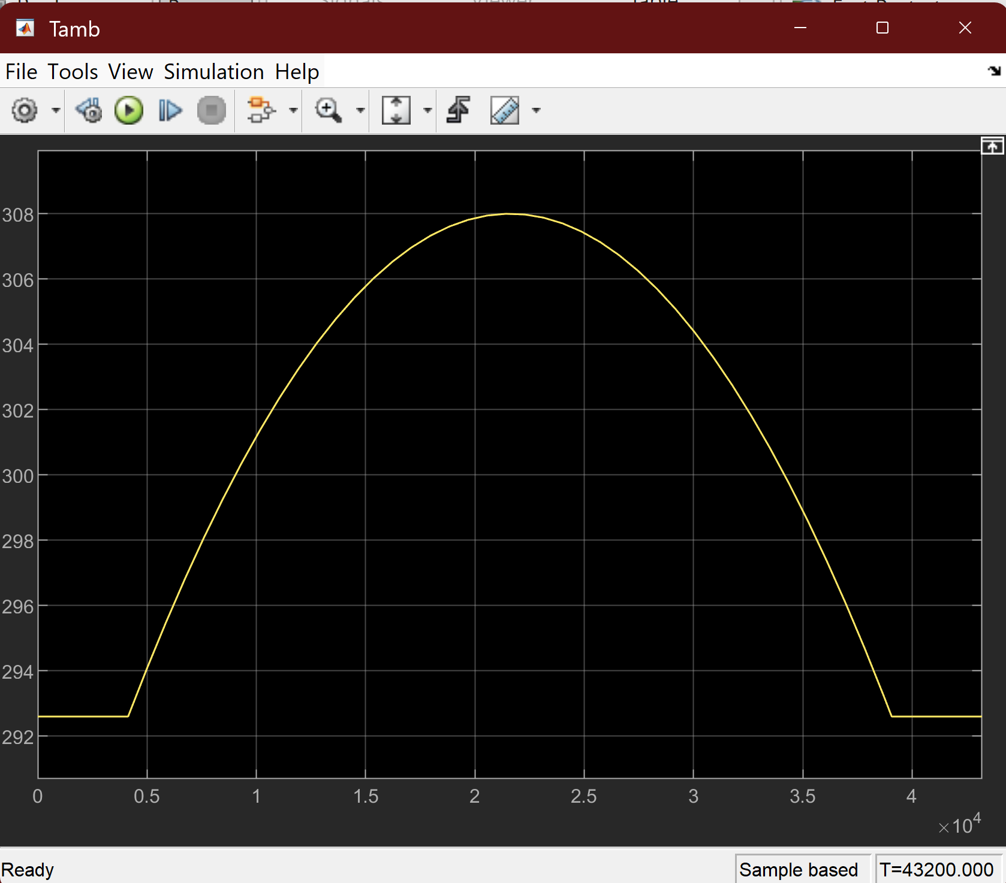
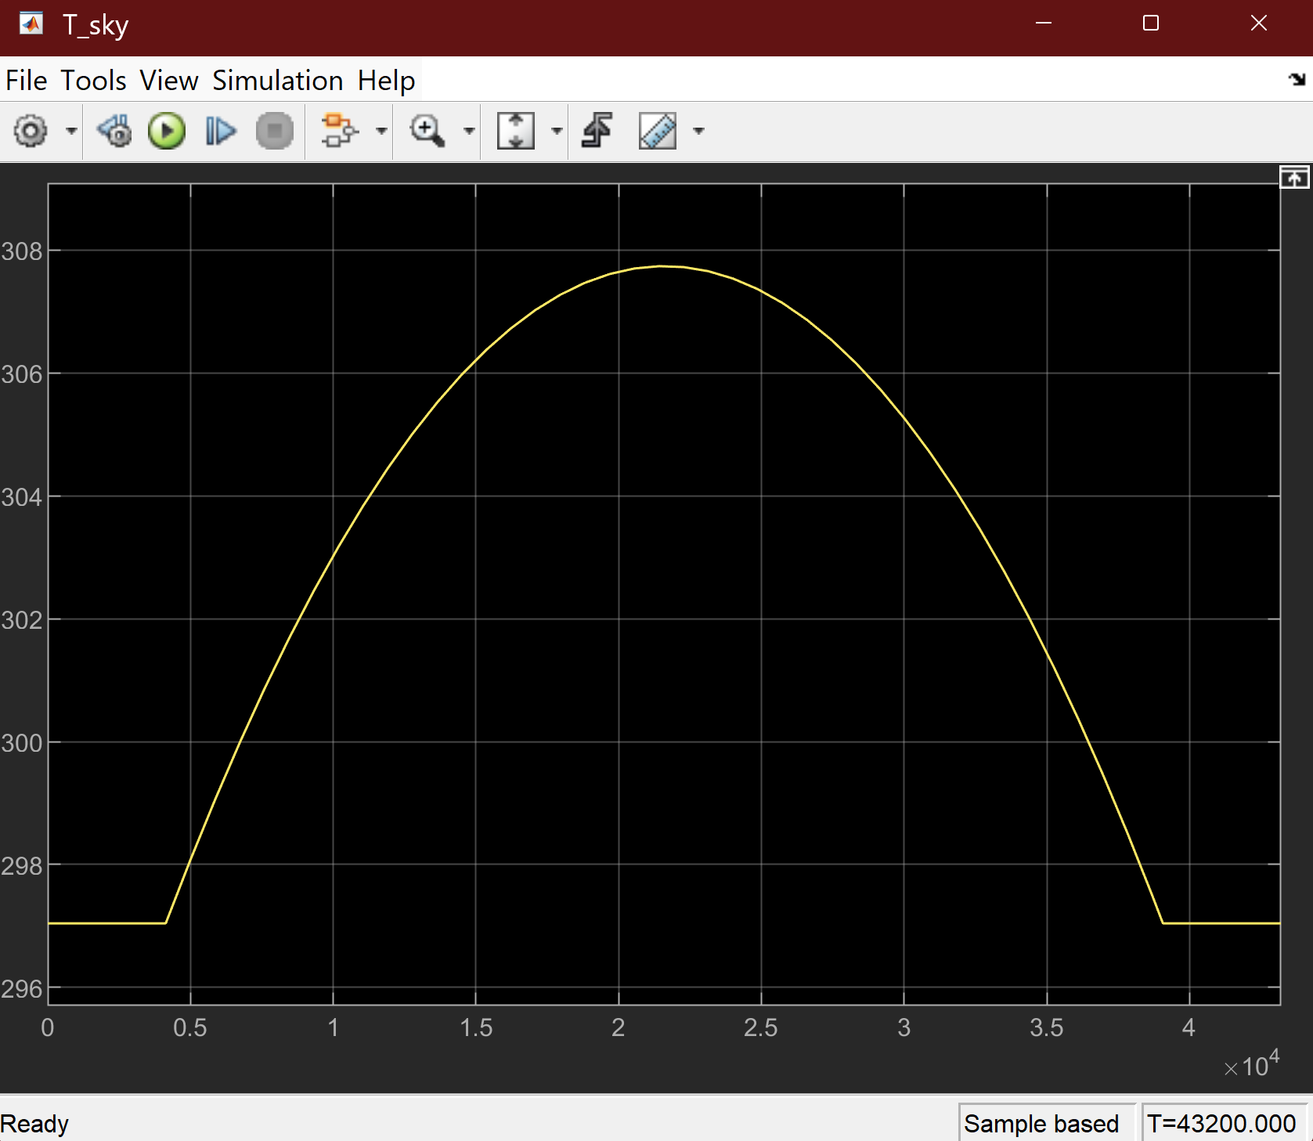
Presented by: Shruthika I.

Slide 8
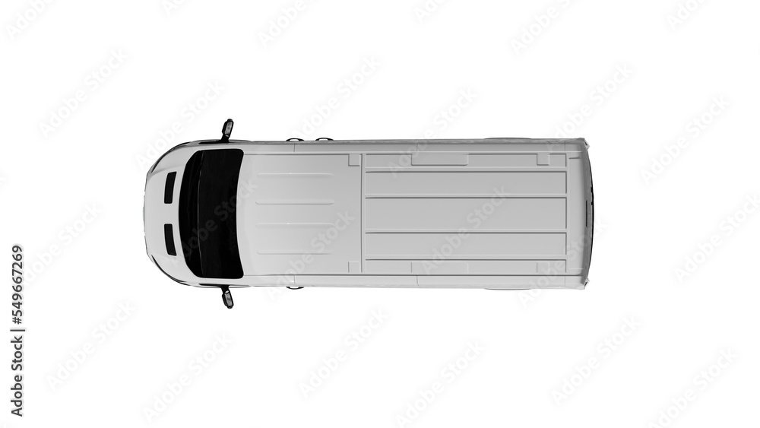
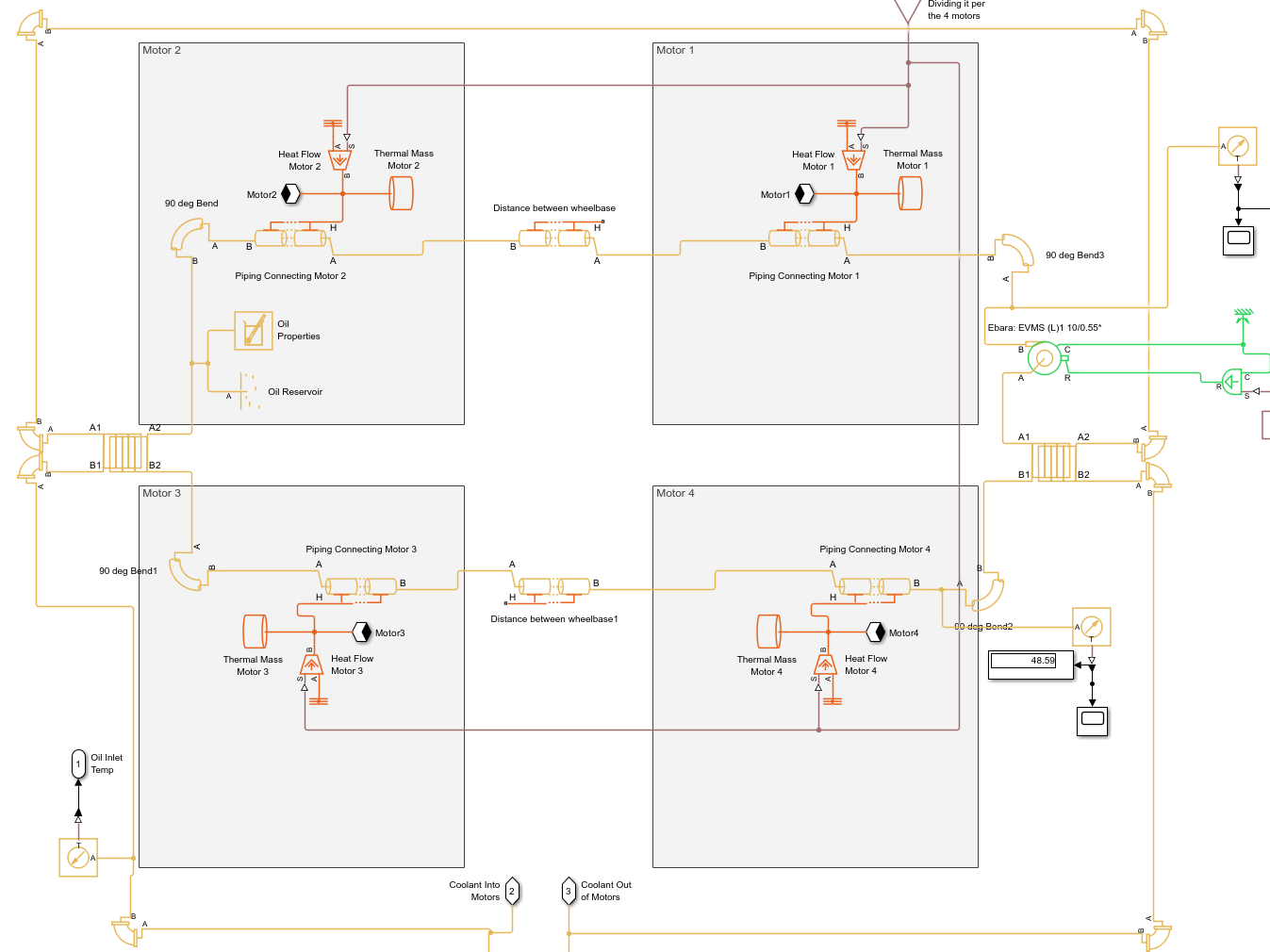
Electric Motor & Gearbox
Presented by: Isai Alcaraz

Slide 9
Electric Motor & Gearbox
Presented by: Isai Alcaraz

Slide 10
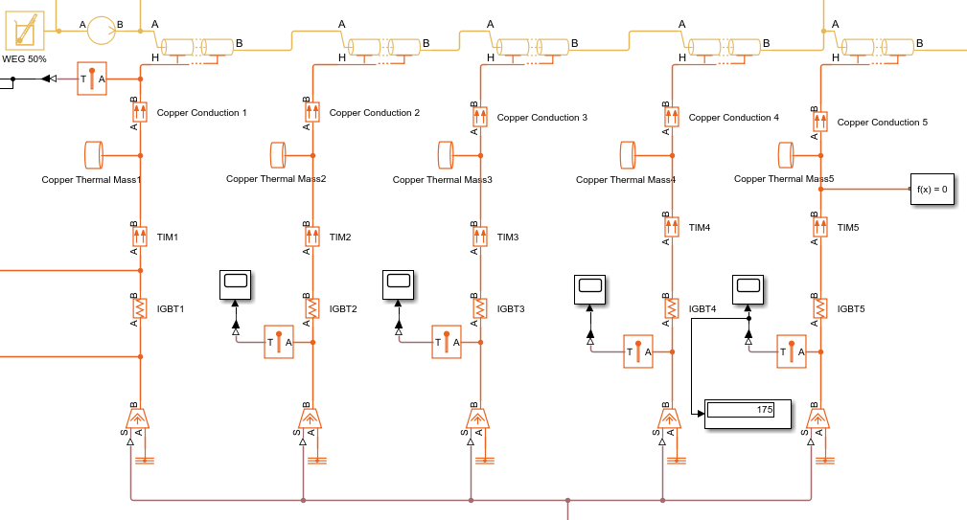
Electrical Inverter
TIM:
Artic Silver 5
K = 8.9 W/m/K
Cold Plate:
Copper
K = 401 W/m/K
IGBT
Rjc = 0.1 K/W
Presented by: Bella

Slide 11
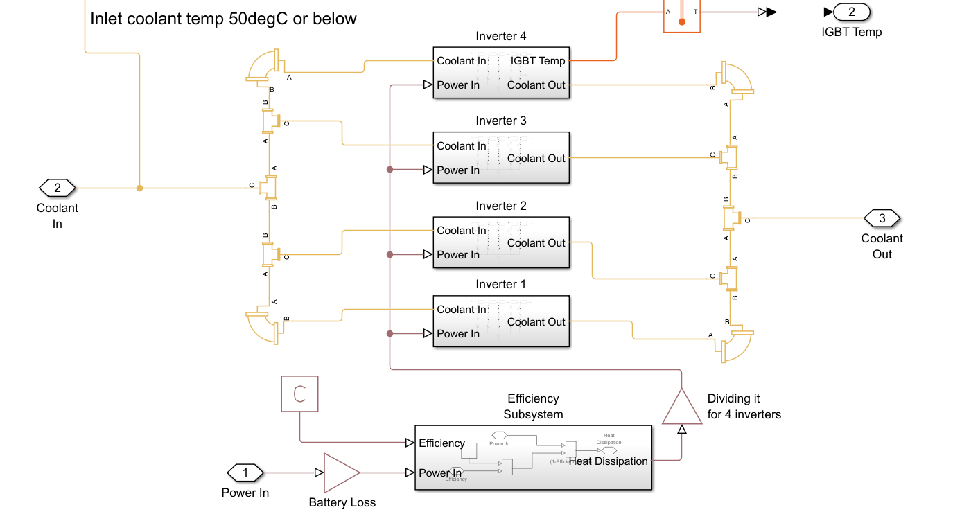
Electrical Inverter – Coolant Attachment
Presented by: Bella

Slide 12
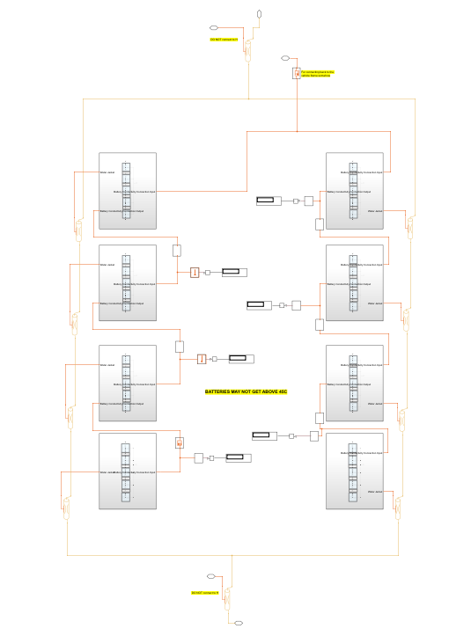
Battery System
8 batteries
Connected to cooling water jacket via 50-3186 NC epoxy (k = 1.38 W/m/K)
Water jacket uses system coolant
50% water/ethylene glycol
Presented by: Maghen Saltzman

Slide 13
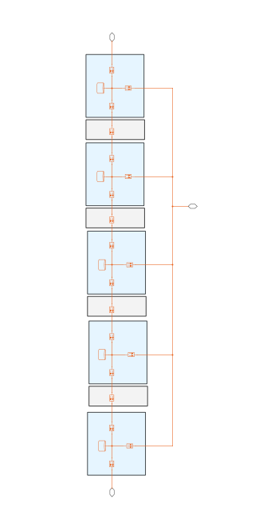
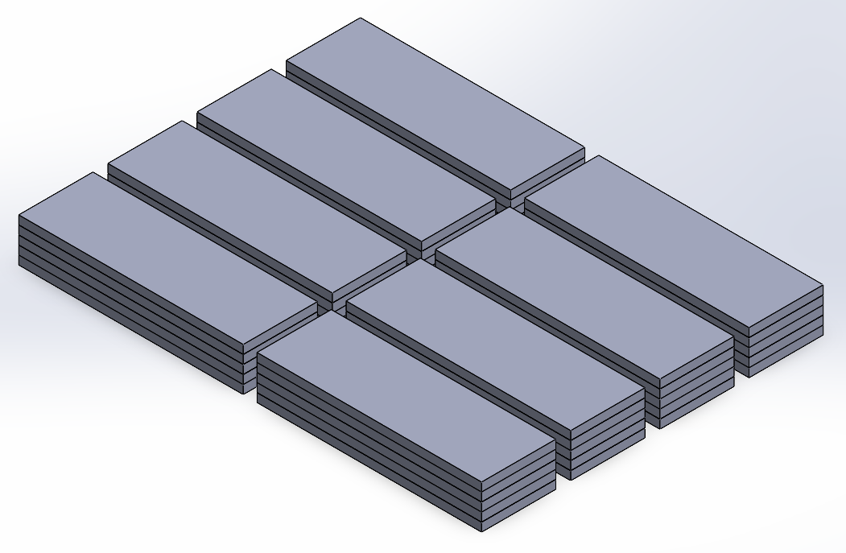
Battery
Each battery is a stack up of 5 Lithum NMC cells
Physical rendering shown below

Slide 14
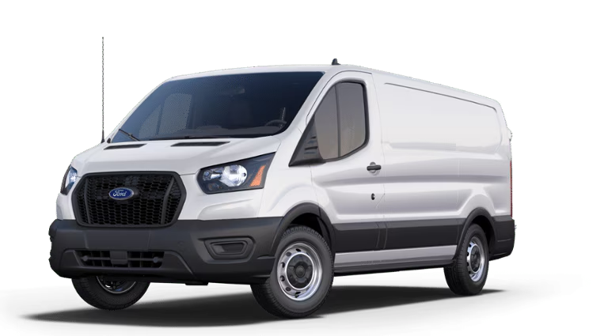
Cabin Interior & HVAC
Loads:
Solar (direct & diffuse)
External temperature
HVAC
Passenger metabolic rate
Outputs:
HVAC required power (COP = 2 [X])
HVAC dissipation to coolant loop
Cabin air temperature
General dimensions using Ford Sprinter
Presented by: Chiara Wu

Slide 15
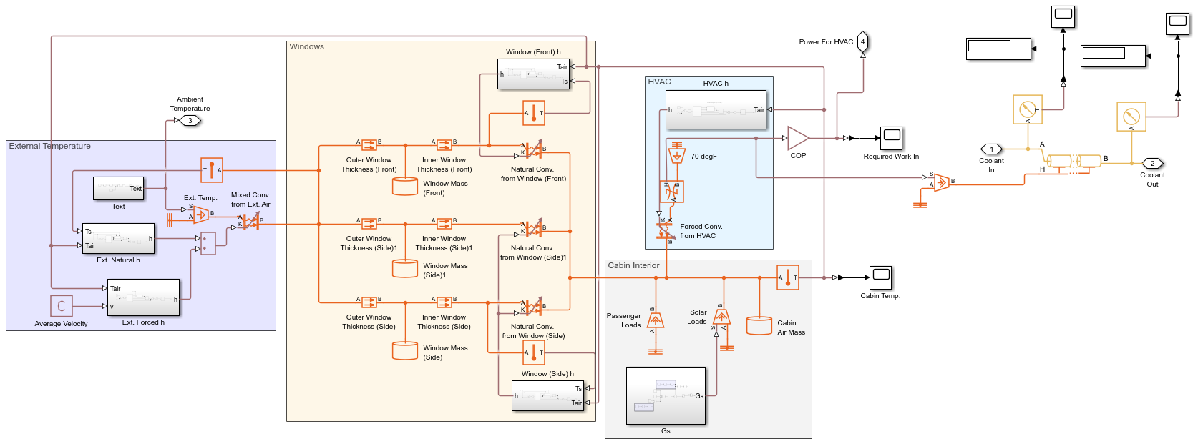
Cabin Interior & HVAC
Presented by: Chiara Wu

Slide 16
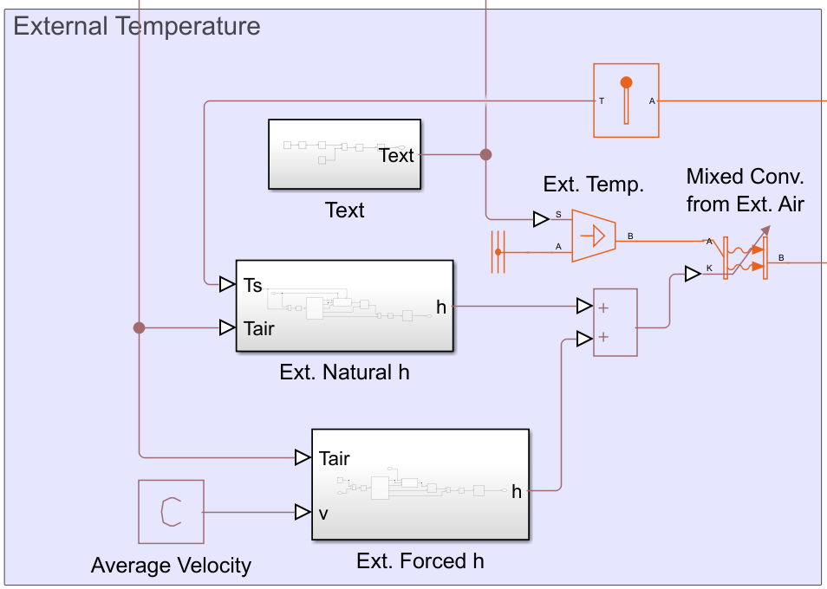
Cabin Interior & HVAC – External Temperature
Presented by: Chiara Wu

Slide 17
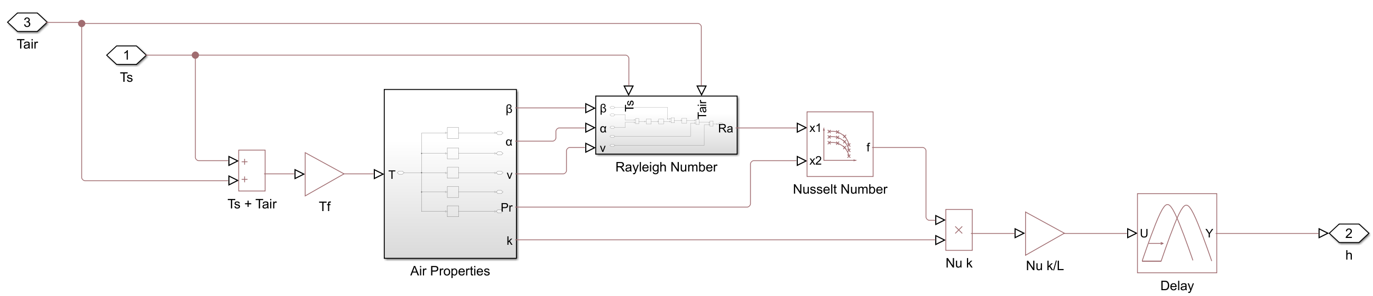
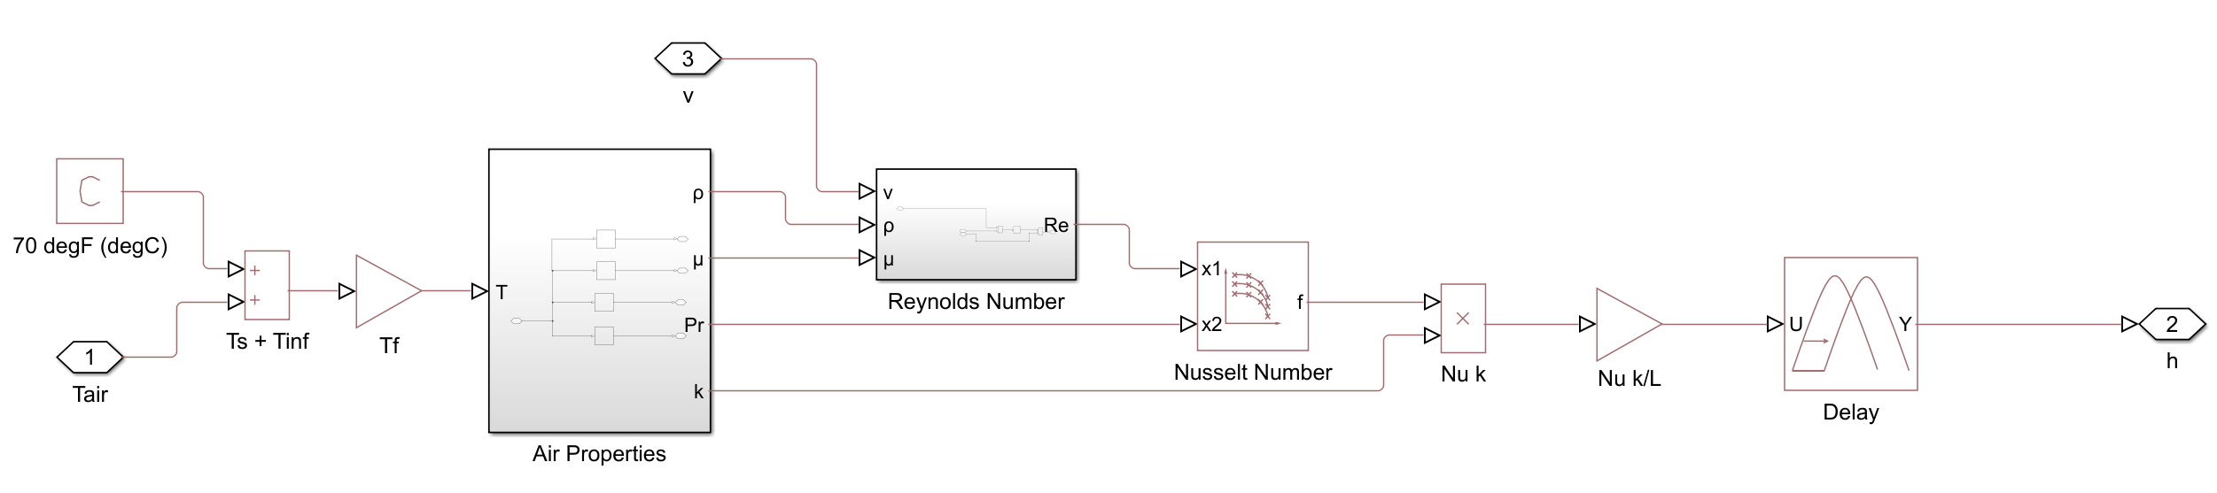
Cabin Interior & HVAC – Convection
Natural Convection
Forced
Convection
Presented by: Chiara Wu

Slide 18
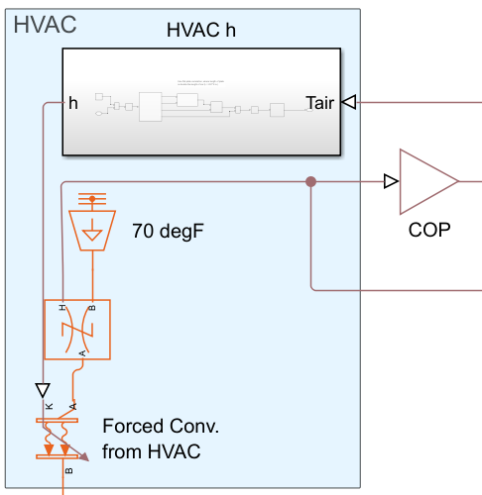
Cabin Interior & HVAC – HVAC
V_{air} = 100 ft/s (https://www.engineeringtoolbox.com/duct-velocity-d_928.html)
Assume uniform temperature of cabin air
Use a COP of 2 to determine required work in (https://pmc.ncbi.nlm.nih.gov/articles/PMC7516462/)
Dissipation to coolant loop
Presented by: Chiara Wu

Slide 19
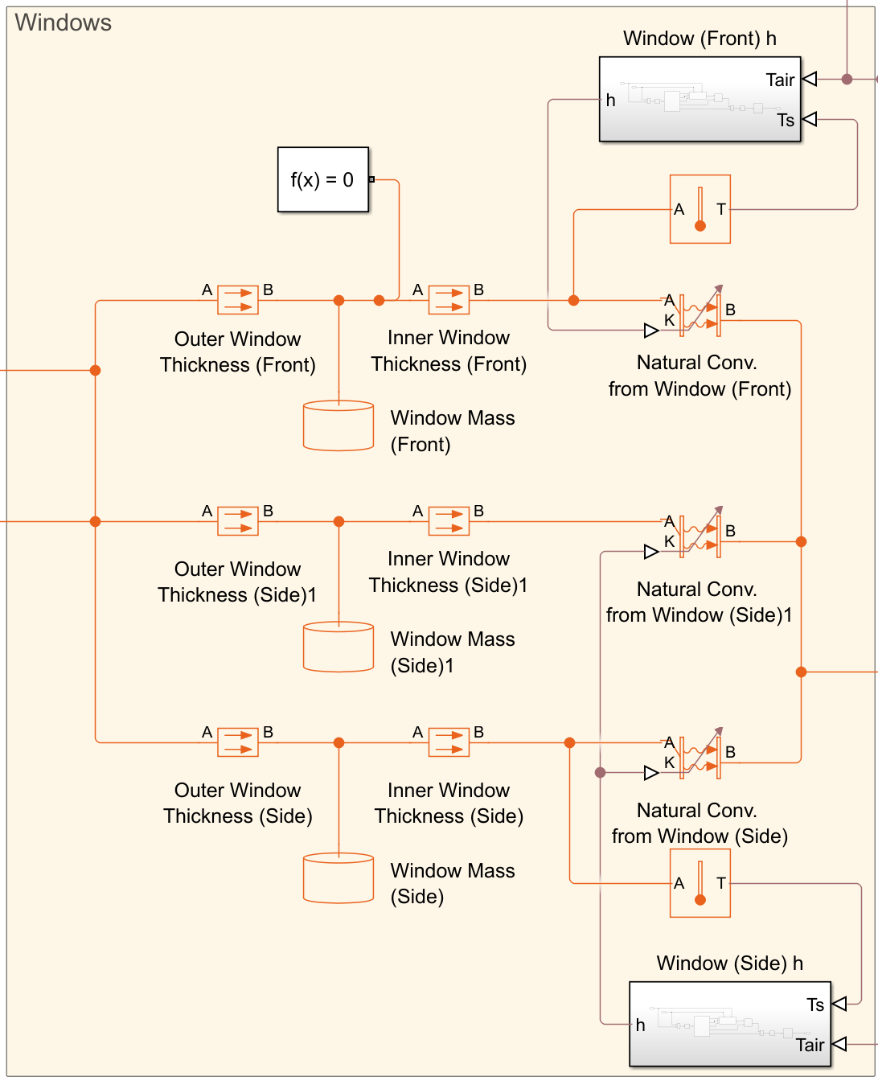
Cabin Interior & HVAC – Windows
Ford Sprinter windows
Front windshield is angled 60° from horizontal
Neglect HVAC forced convection
Neglect all radiation but transmittance
Presented by: Chiara Wu

Slide 20
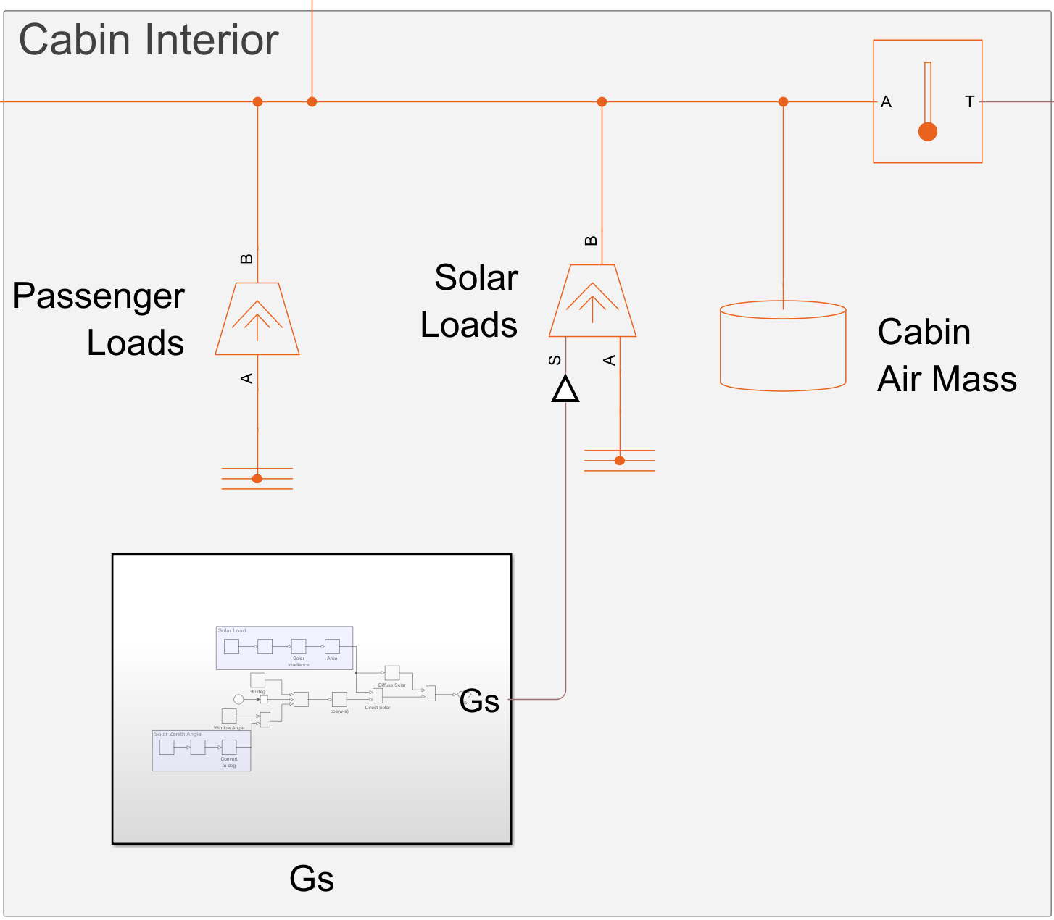
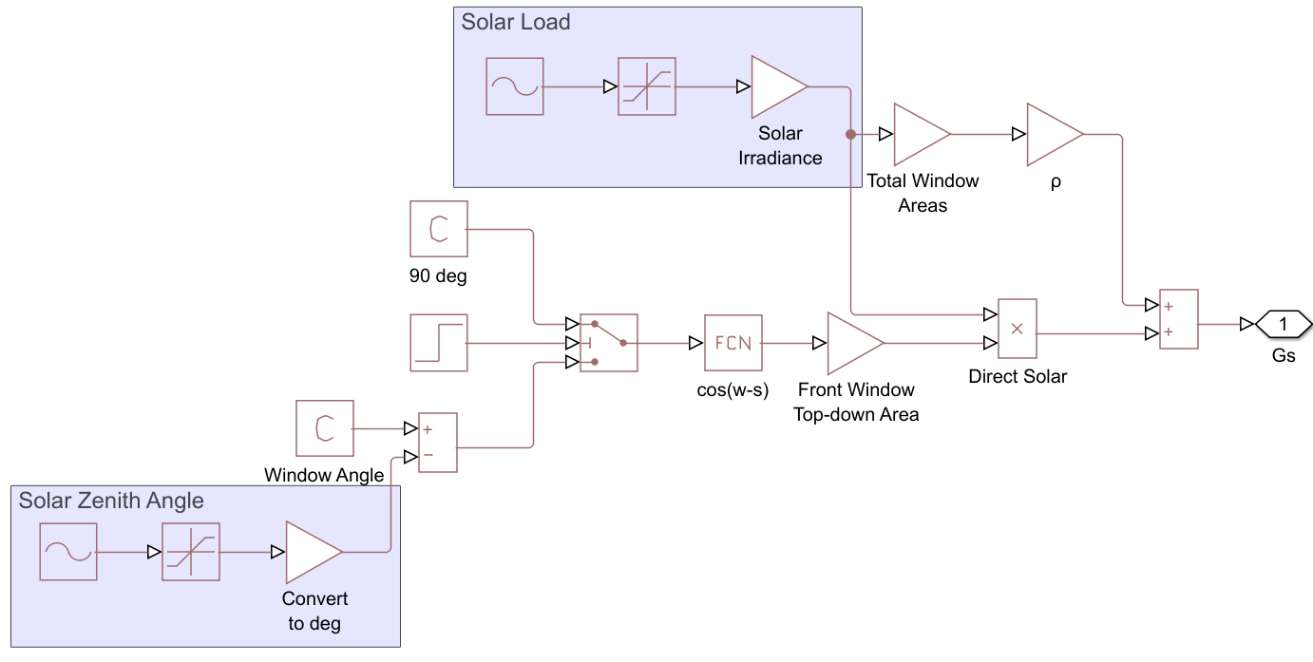
Cabin Interior & HVAC – Cabin
Presented by: Chiara Wu

Slide 21
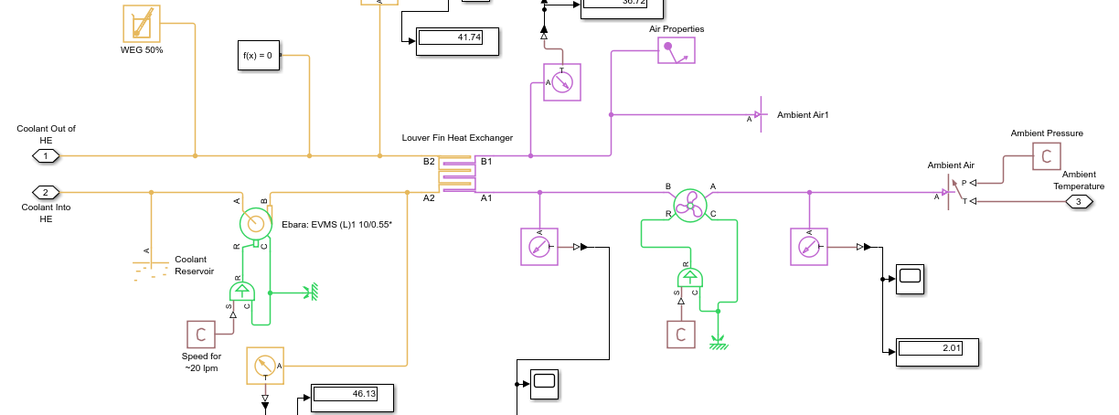
Radiator System
Presented by: Isai Alcaraz

Slide 22
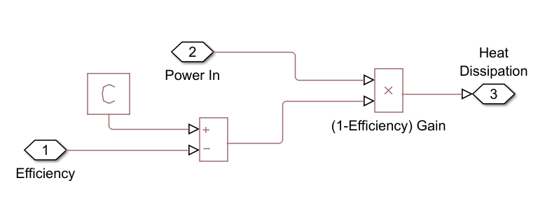
Efficiency Subsystem
Presented by: Isai Alcaraz

Slide 23
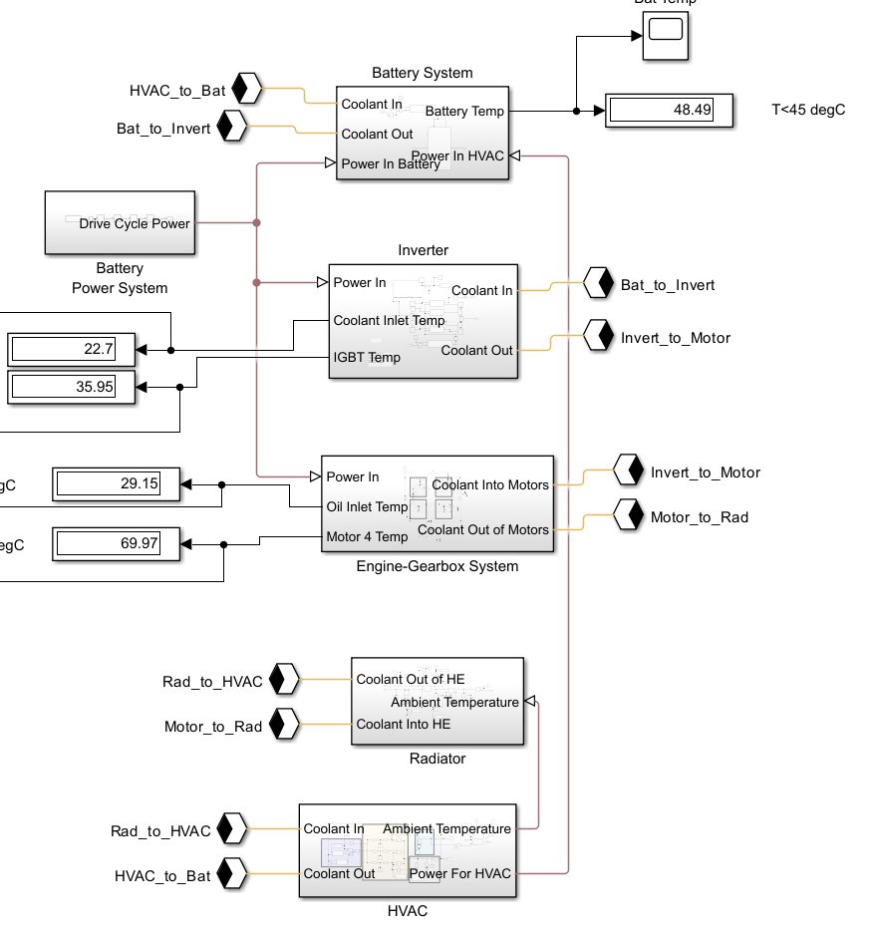
Full Model Schematic
Presented by: Isai Alcaraz

Slide 24
References
[6] Epoxies Etc., “50-3186 NC: Very High Temperature Resistant Epoxy Adhesive,” Accessed: May 20, 2025. [Online]. Available: https://epoxies.com/wp-content/uploads/2022/05/50-3186NC.pdf
[3] U.S. Environmental Protection Agency, “Dynamometer Drive Schedules.” Accessed: May 20, 2025. [Online]. Available: https://www.epa.gov/vehicle-and-fuel-emissions-testing/dynamometer-drive-schedules
[4] EVE Energy Co., Ltd., “EVE 3.65V 50.5Ah lithium NMC pouch battery cell.” Accessed: May 20, 2025. [Online]. Available: https://www.evlithium.com/nmc-battery/d21-50ah-lithium-pouch-battery-cell.html

